Slide 1

Topic: Bivariate data
EQ: How do I read Scatterplots?
Instructions:
Read the instructions on slide 1 (don’t forget to listen to the audio icon)
Open up or get your hard copy of the EST content tick list from Term 1 Week 5 and add in any notes from last lesson
Read slide 3
Answer the questions to the example on slide 4. Try not to look at the solutions until you have had a go yourself
On slide 5 it asks your to complete Term 1 Week 9 Lesson 3_ Reading Scatterplots worksheet. Submit your work in the submission folder , “Term 1 Week 9 Lesson 3_ How do I read scatterplots?”
Complete Mathspace task _Term 1 Week 9 Homework_ Comparing two variables

Slide 2
Topic: Bivariate Data
EQ: How do I read Scatterplots?

Slide 3
24
7
30
Date:
Bivariate Data
EQ: How do I read Scatterplots?
A scatterplot is used to determine if there is a relationship between two numerical variables.
Once you have created a scatterplot you need to be able to use it to see if there is a relationship between the two variables plotted.
The next slide (slide 4) shows you how you can go about reading and interpreting basic things from the scatterplot. Use this example to answer the questions on the worksheet that is attached to this PowerPoint.

Slide 4
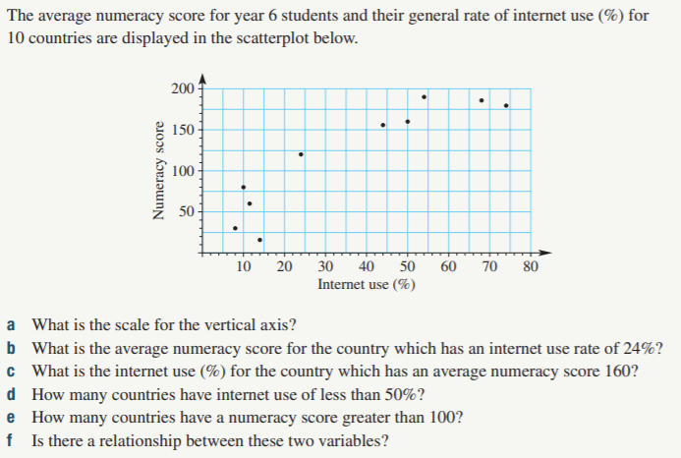
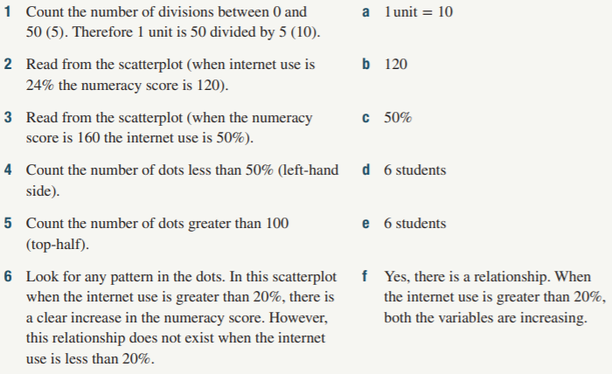
24
7
30
Date:
Bivariate Data
EQ: How do I read Scatterplots?
Example
Solution

Slide 5
24
7
30
Date:
Bivariate Data
EQ: How do I read Scatterplots?
1. Complete the Term 1 Week 9 Lesson 2_ Reading Scatterplots worksheet.
2. Submit a photo of your work or the completed word document into the submissions folder under the correct folder
3. Complete Mathspace task _Term 1 Week 9 Homework_ Comparing two variables

